Slide 1
Secure data hiding in images using stegnography
CAPSTONE PROJECT
Presented By:
Student Name : pydi soujanya
College Name & Department :Sri Sivani College Of Engineering & Computer Science.

Slide 2
OUTLINE
Problem Statement
Technology used
Wow factor
End users
Result
Conclusion
Git-hub Link
Future scope

Slide 3
Problem Statement
🔒 Secure Image Encryption & Decryption Using Pixel-Level Encoding

Slide 4
Technology used
Python
Cv2 Library
Operating system
The solution leverages Computer Vision (OpenCV) for image manipulation.
Python for logic implementation, and pixel-level encoding to embed secret messages within an image. It also incorporates automated message retrieval through an authentication-based decryption mechanism, ensuring that only authorized users can access the concealed information.

Slide 5
Wow factors
Invisible Data Encoding: The hidden message is indistinguishable from the original image.
Dual-Functionality: The system not only encrypts a message into an image but also restores the original image post-decryption, ensuring zero data loss.
Lightweight & Efficient: Unlike traditional cryptography, which alters the format of data, this technique embeds the message within pixel values, making it highly efficient for real-world use.
user Authentication: Ensures security by requiring a passcode for decryption, preventing unauthorized access.
Automated Image Restoration: Unlike typical steganography methods that irreversibly alter the image, this solution restores the original image seamlessly after decryption.

Slide 6
End users
1. Privacy-conscious Individuals
2. Digital Artists and Content Creators
3.Cybersecurity Enthusiasts and Beginners
4. Small Businesses and Startups
5. Journalists and Activists
6. Forensics and Investigative Teams
7.Teachers and Educators
8.Banking sectors

Slide 7
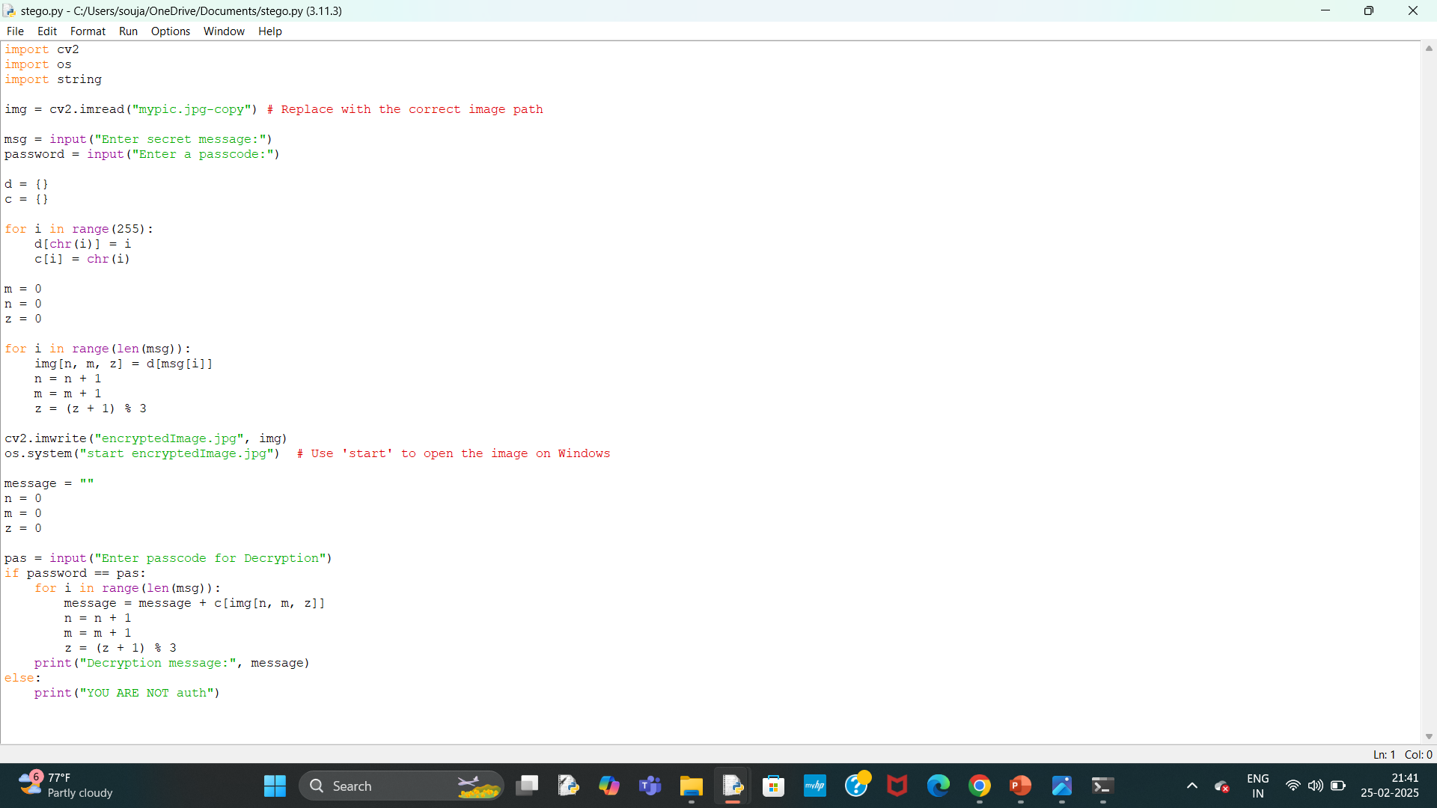
Results

Slide 8
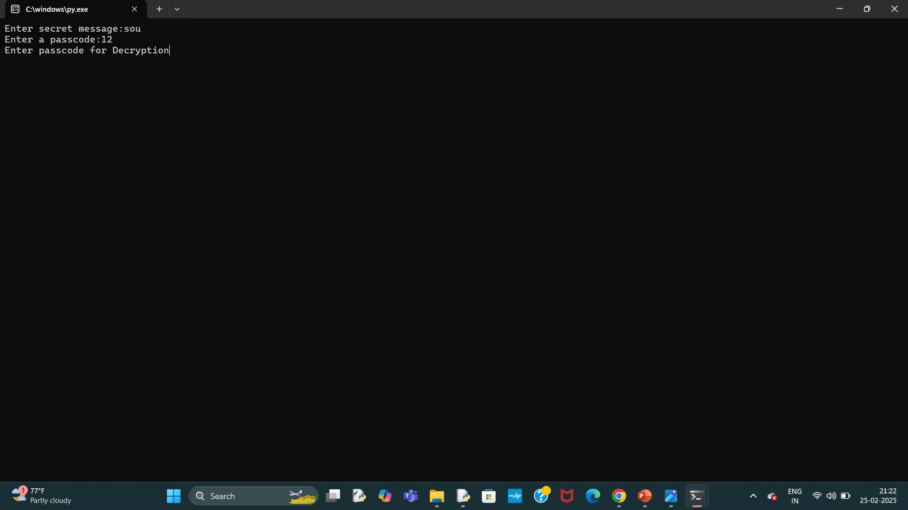
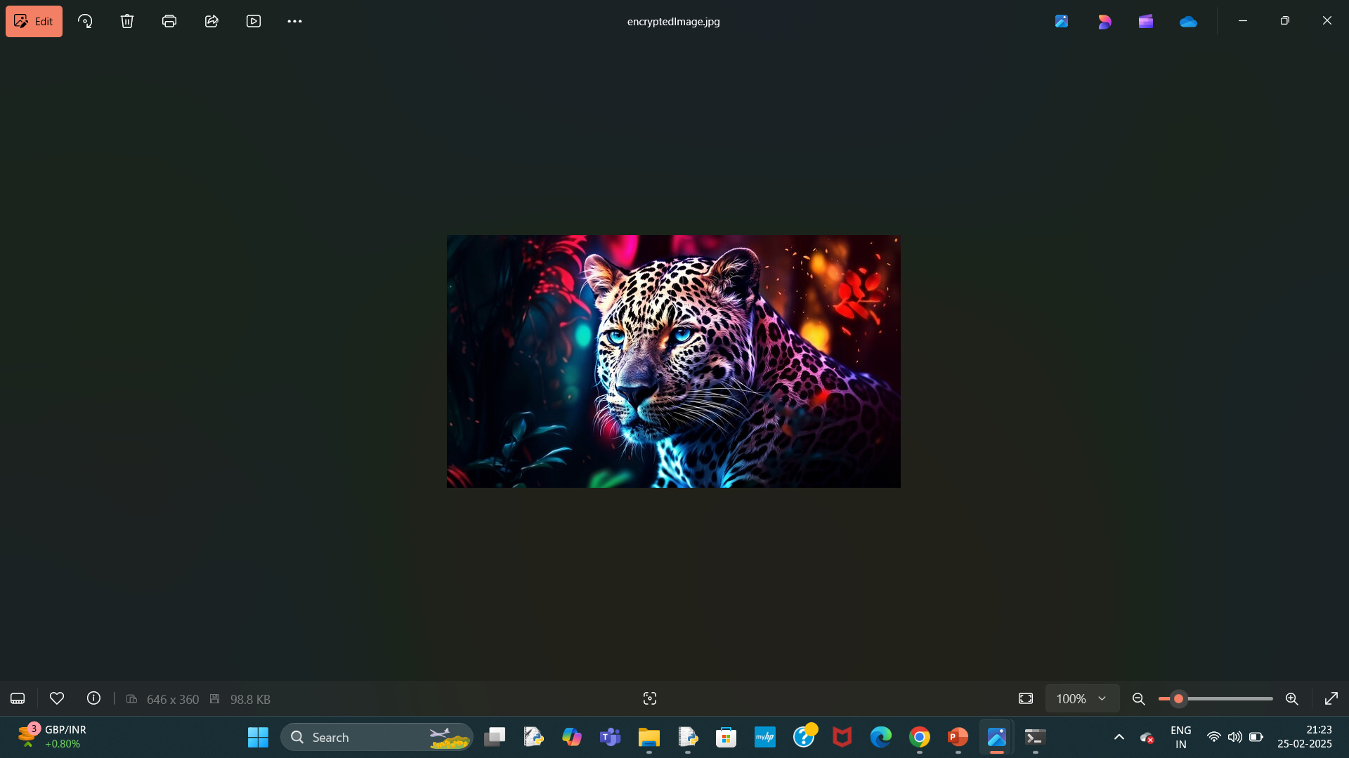
Results

Slide 9
Conclusion
This project presents an innovative and highly secure approach to data hiding, blending computer vision and steganography to create an advanced encryption technique. By utilizing pixel manipulation at a granular level, it ensures both secrecy and data integrity, making it a revolutionary step in secure communication.

Slide 10
GitHub Link
https://github.com/pydisoujanya/stego.git

Slide 11
Future scope(optional)
🔹 Deep Learning Integration: AI-based pattern recognition can be used to further enhance message security.
🔹 Cloud-Based Deployment: Secure, image-based communication over distributed networks.
🔹 Multi-Layer Encryption: Combining steganography with cryptographic algorithms like AES for double-layer security.
🔹 Cross-Platform Support: Extending the technology to mobile devices and cloud applications for real-time secure messaging.

Slide 12
THANK YOU

